Slide 1
Guardian of Health Safety

Slide 2





Welcome to Our Presentation
Sakir Hossain Faruque
ID: 203-15-3862
Junayed Arefin
ID: 201-15-3294
Maruf Hossain
ID: 201-15-3470
Faiza Noshin
ID: 203-15-3877
Osman Goni Og
ID: 203-15-3930

Slide 3

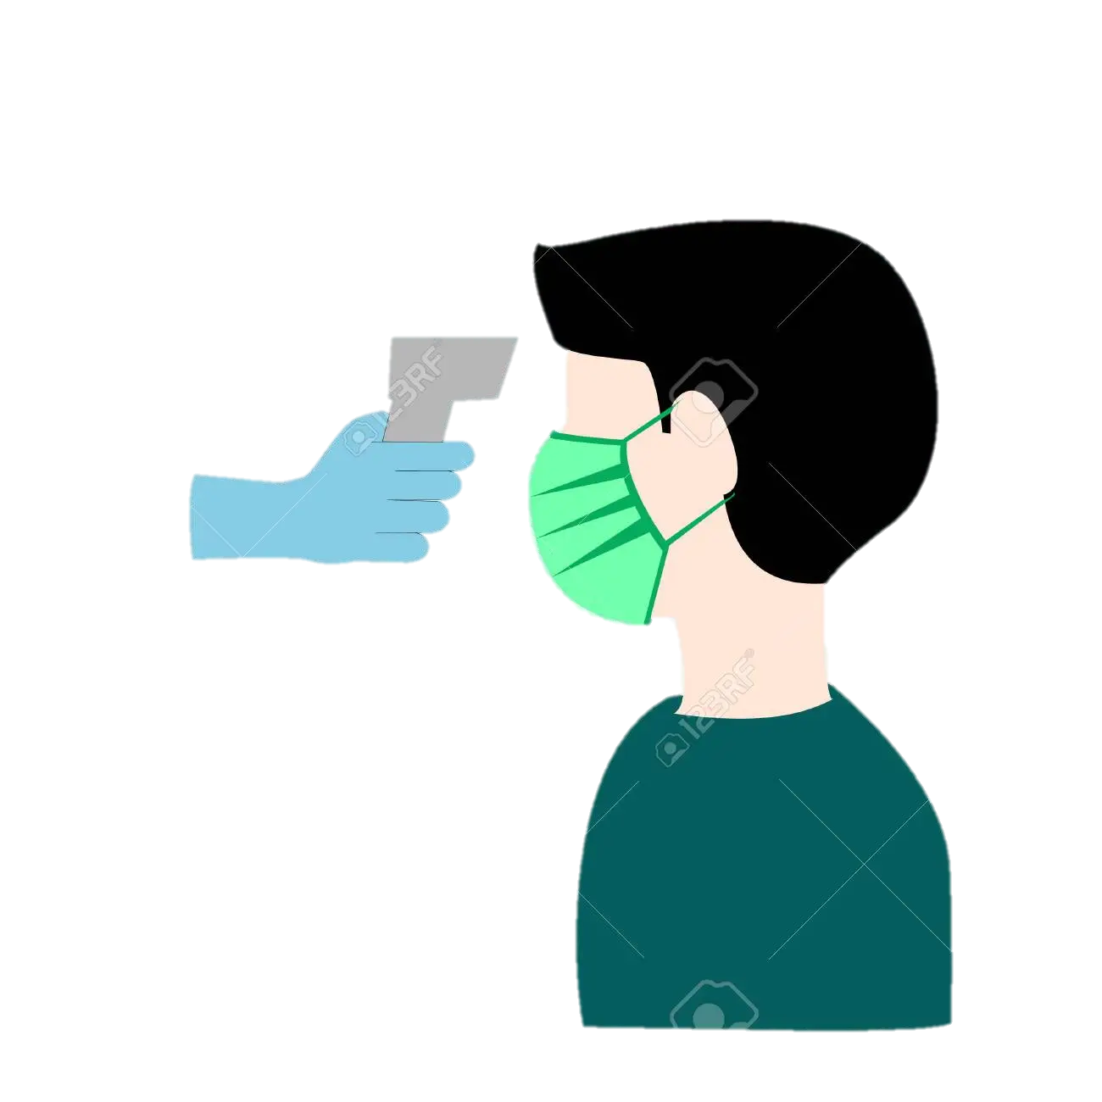



Project Concept
01
Detect Temperature
Case: 01
Case: 01
02
03
Temp: 96°F-99°F
Washed Hand
Request to Wash Hands
Chance to Get In
Didn’t
Washed Hand
Case: 02
03
Temp: 100°F or
up to 100°F
Case: 02
Request to Return
02
Request to Return

Slide 4

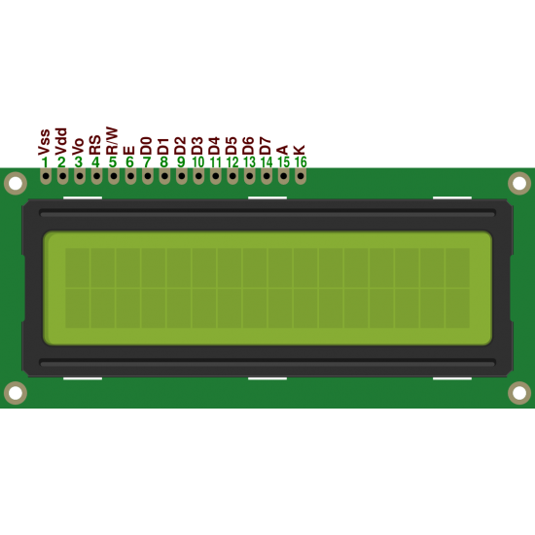






How Our System Works
Temp: 98°F
Wash Hand
Please Enter
Temp: 101°F
Didn’t Wash Hand
May Covid Positi
Time Out !
Please Return
Please Return

Slide 5

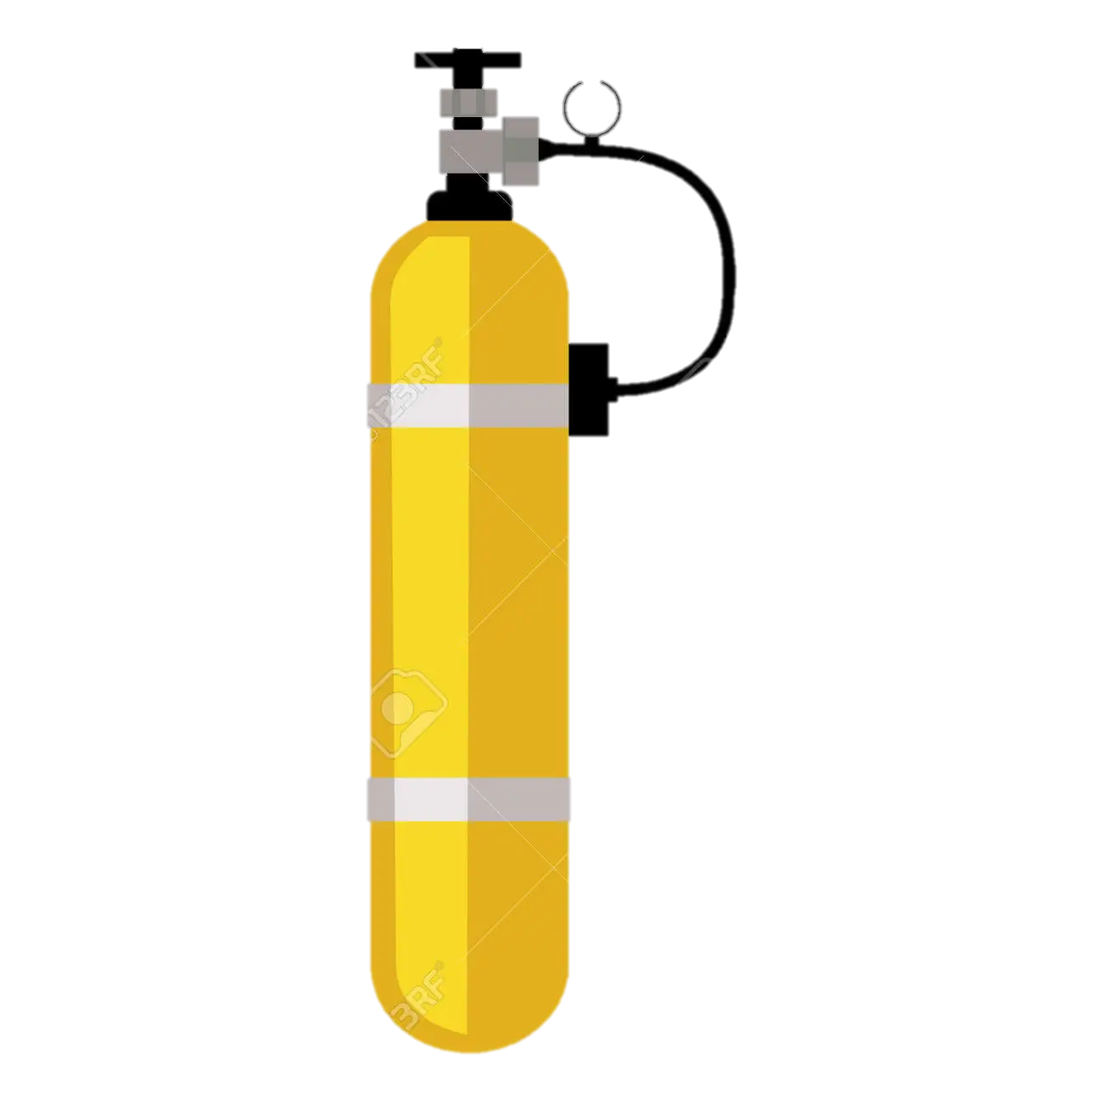


Motivation
High Transmission
Easy Transmission
Deficit of Health
Stuffs

Slide 6
Advantages
01
03
02
Efficiency
Budget
Activity
Highly efficient to detect temperature
Very low cost to purchase
Allow to enter after cleaning hand

Slide 7
Goals
02
01
03
Available for market
Make more efficient
Add more features

Slide 8
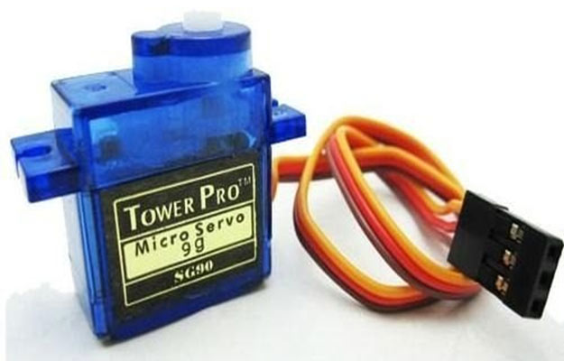

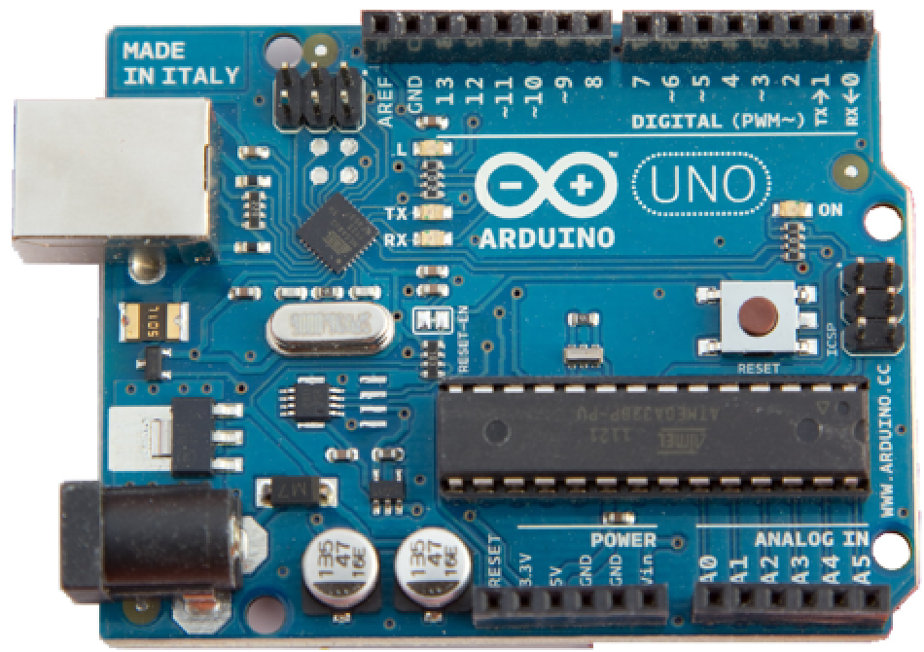
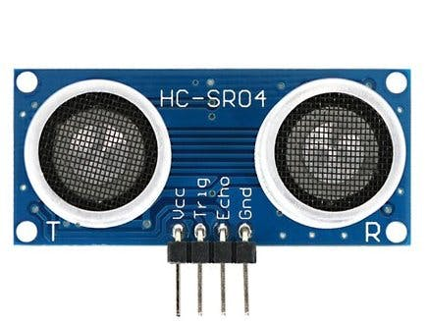
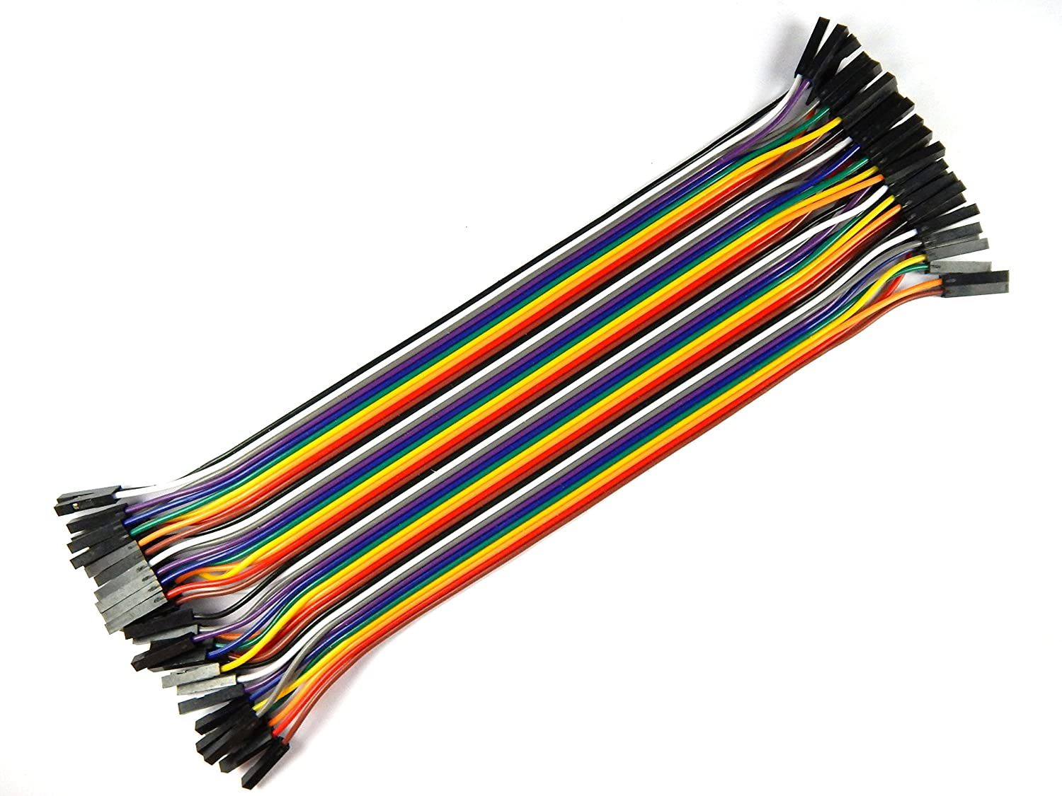
Equipments
Servo Motor
Ultrasonic Sensor
Arduino Uno
Mlx90614
Jumper wire

Slide 9
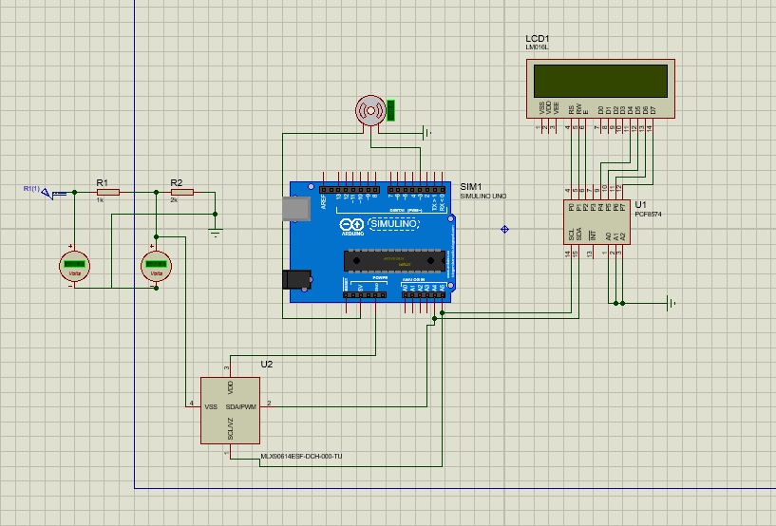
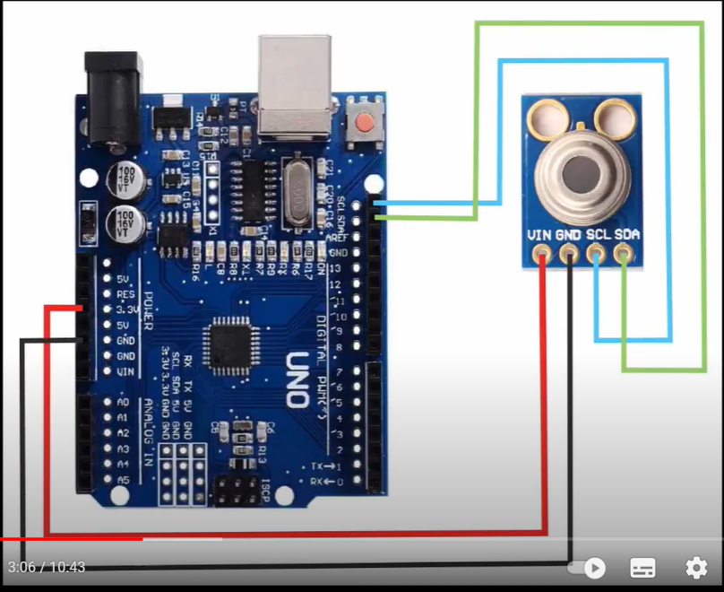
Circuit Design

Slide 10
PARTICIPANT REVIEWS
Sabit
Md. Mahfuj Sarker
Very nice concept. Well done!
Very nice work! Keep it up!
--Polash
This project is so good.i.Good idea. keep it up,
Safety caution idea. Very helpful for the future epidemic situation

